Slide 1
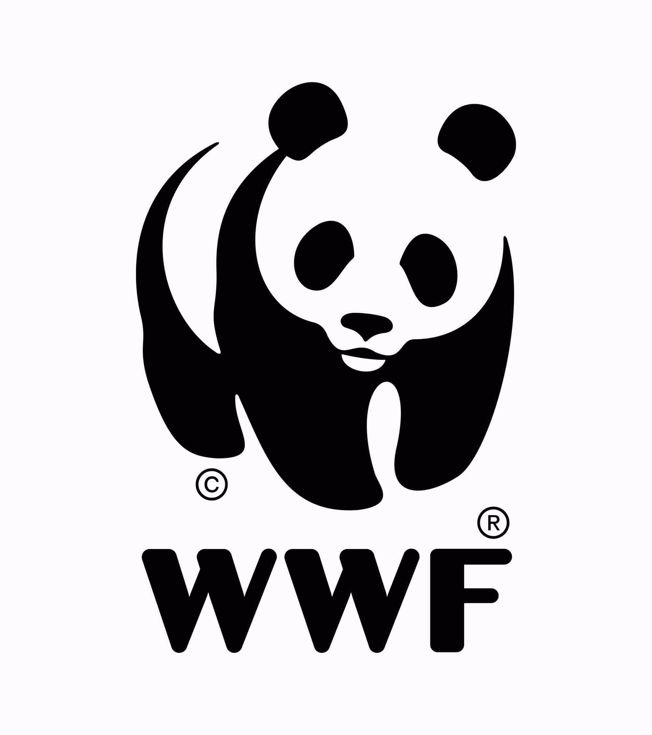
Introduction to the Circular Economy
“Make it circular! A gamified introduction to circular business models in a corporate setting”
Notes:
Before we get going with the “Make it circular” strategy game, this presentation will provide participants with a common basic understanding of the Circular Economy.

Slide 2
Agenda
01
02
03
04
05
Why is there a need for a Circular Economy?
What is a Circular Economy?
What does it take to implement it?
What do circular business models involve?
Presentation of the strategy game
Notes:
The content of this presentation focuses on the following topics:
An explanation of the need to transition to a Circular Economy
A description of the objectives of a Circular Economy
The role of circular ecosystems and digital technologies in the implementation of a Circular Economy
An introduction to the concept of circular business models
A presentation of the strategy game and the materials to be used

Slide 3
01
Why is there a need for a Circular Economy?

Slide 4
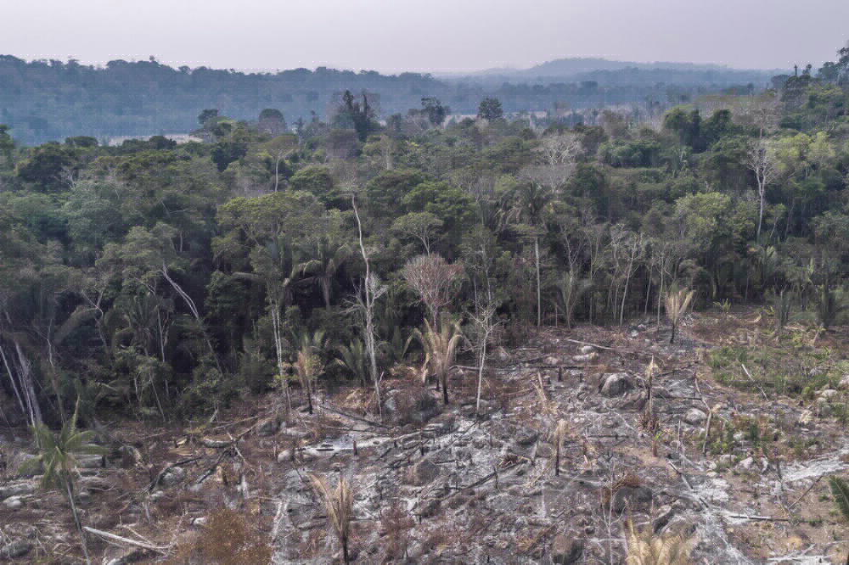
Our planet has reached its limits.
We’re using more than we have…
Global consumption of resources has more than tripled from 27 billion tonnes in 1970 to 92 billion tonnes in 2017.
Humanity is currently consuming the resource equivalent of
1.75 Earths every year.
Picture credit: WWF Brazil
Sources: National Footprint and Biocapacity Accounts (2022)
Notes:
Our planet is at its limits. We’re using more than we have. Global resource consumption has more than tripled from 27 billion tonnes in 1970 to 92 billion tonnes in 2017, meaning that humanity is currently consuming 1.75 Earths of resources every year.

Slide 5
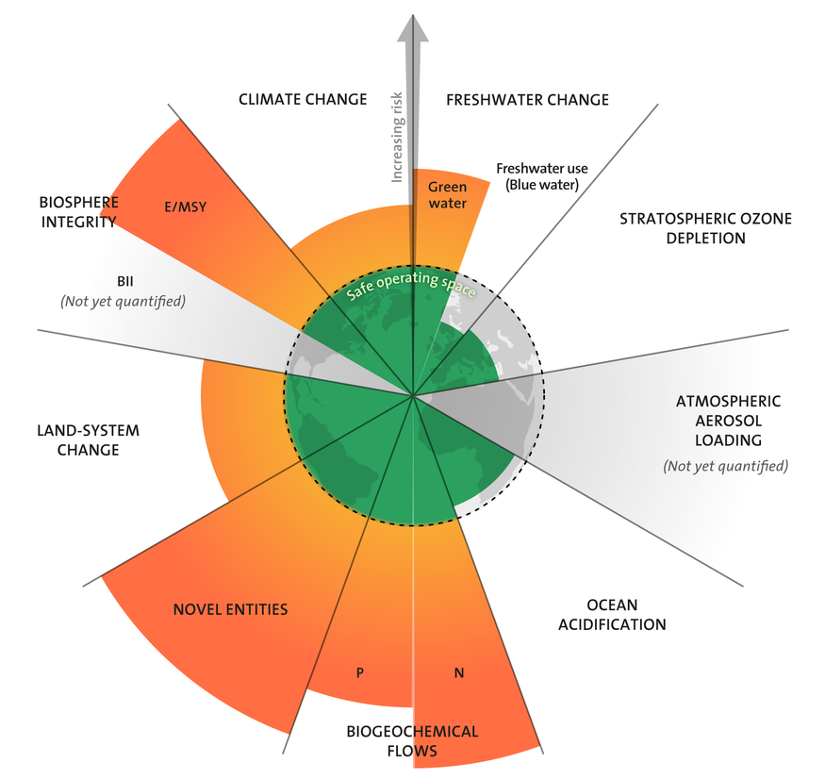
Our planet has reached its limits.
…The effects are catastrophic!
Resource consumption is driving climate change and biodiversity loss.
50% of global greenhouse gases...
and 90% of biodiversity and water stress...
...are attributed to resource extraction and production.
Source: International Resource Panel (2019), International Resource Panel (2019), Stockholm Resilience Centre (2022)
Notes:
And this leads to catastrophic effects as resource consumption is driving climate change and biodiversity loss.
The diagram illustrates planetary boundaries. Planetary boundaries are the Earth’s ecological limits and exceeding them will jeopardise the stability of the Earth’s ecosystem and thus the basis for human life. They were originally developed by a 28-member group of Earth system and environmental scientists led by Johan Rockström (Stockholm Resilience Centre) and first published in 2009. Planetary boundaries define humanity’s safe operating space. Originally, the following boundaries were considered to have been exceeded: climate change, biochemical cycles, land use, biodiversity. In addition, the freshwater and novel entities boundaries have recently also been defined as (partially) exceeded.

Slide 6
Our linear economy is accompanied by significant losses in value creation and entails high risks for companies.
Linear system
Current processes are highly inefficient:
Only 5% of the average raw material value is recovered after the first use of a product
Only 2% of global plastic packaging waste is materially recycled to a high quality, corresponding to an annual loss in value of 95% (70-105 billion euro)
Pressing issues surround our dependency on raw material imports and supply reliability:
Europe imports 60% of its fossil fuels and metal resources; the EU has classified 20 materials as critical with regard to supply reliability.
Global demand for cobalt will probably more than double by 2025, mainly due to electric vehicle sales.
At the same time, many industries are focusing on renewables such as wood and fibre products as alternatives to fossil resources.
Raw material extraction & production
Use
Waste
Sources: McKinsey Center for Business and Environment, Ellen MacArthur Foundation & SUN (2015), WWF Deutschland (2022), McKinsey Basic Materials Institute (2018), Ellen MacArthur Foundation (2013), McKinsey Global Institute (2011), Circle Economy (2018), SYSTEMIQ, McKinsey Center for Business and Environment, Ellen MacArthur Foundation & SUN (2018)
Notes:
The linear economic model of “take, make and dispose” has not only led to dramatic environmental impact, it is also highly inefficient and involves major losses in value creation.
In addition, current dependencies on raw material imports will further intensify in the future: the current energy and mobility transition is accompanied by a change in demand from fossil to metallic raw materials and rare earths. The demand for renewable materials is also increasing and, in the foreseeable future, will be impossible to meet.

Slide 7
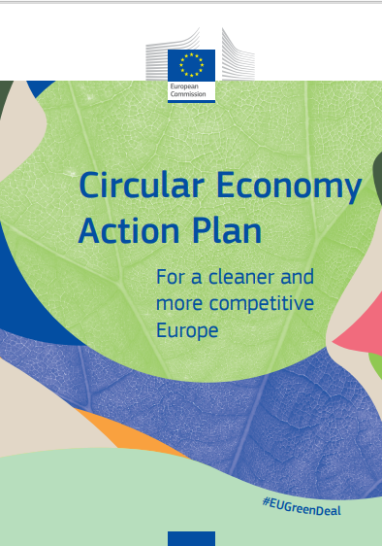
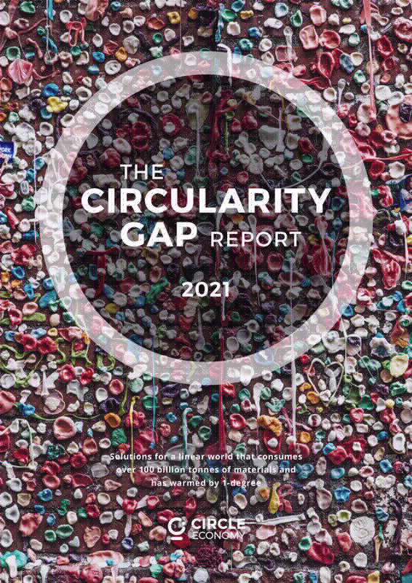
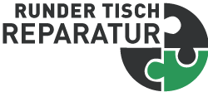
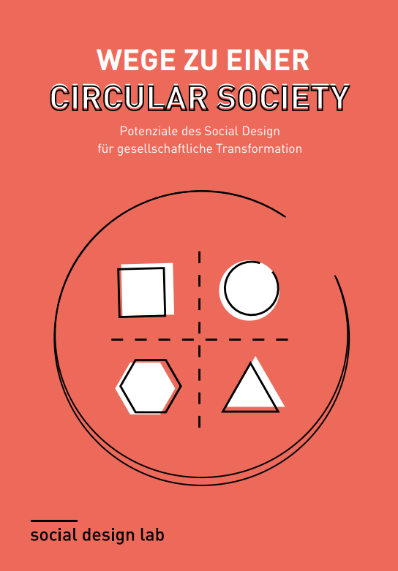
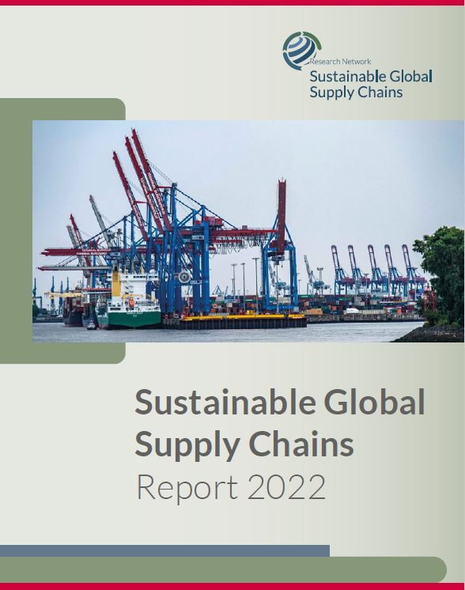
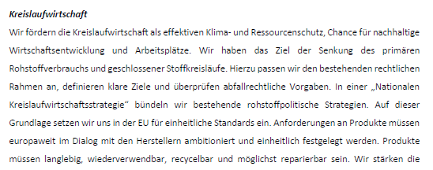
Pressure and demand for circular solutions are increasing.
Policy makers
are creating an increasingly concrete framework for a Circular Economy.
Scientists
are forcefully demonstrating the necessity for and pathways towards a Circular Economy.
Society and businesses
are becoming increasingly committed and are actively demanding sustainable
solutions.
Scientists
Sources: United Nations, European Union, Bundesregierung, IRP, Research Network Sustainable Global Supply Chains, Circle Economy, CEID, Runder Tisch Reparatur, BDE & BNW, social design lab & Hans Sauer Stiftung, DIN, Prevent alliance
Notes:
The Circular Economy is an important approach to solving these crises.
The environment for the development of circular solutions is looking promising.
Policy makers are setting out an increasingly concrete framework.
The idea of the Circular Economy is reflected in the Sustainable Development Goals of the United Nations. Goal 12 reads “Ensure sustainable consumption and production patterns”. https://sdgs.un.org/goals
In Europe, the European Commission’s Circular Economy Action Plans have set out an ambitious vision for the Circular Economy. https://environment.ec.europa.eu/strategy/circular-economy-action-plan_en
Germany’s 2021 Coalition Agreement includes important declarations of intent for the implementation of a Circular Economy in Germany. https://www.bundesregierung.de/breg-de/service/gesetzesvorhaben/koalitionsvertrag-2021-1990800
Scientists are increasingly forcefully demonstrating the need for the Circular Economy and indicating ways to get there.
The International Resource Panel has forcefully demonstrated the impact of resource use (see previous slides).
In 2021, the Circularity Gap Report identified many possible solutions as to how a globally implemented Circular Economy could contribute to achieving climate goals, including approaches in the areas of housing, food and mobility, among others. https://www.circularity-gap.world/2021
In Germany, the Circular Economy Initiative Deutschland, together with stakeholders from politics, business, science and society, has developed a roadmap that identifies concrete fields of action and measures for the transition to a Circular Economy. https://www.circular-economy-initiative.de/
The Circular Society Roadmap project is using a transdisciplinary format to work out how society should be transformed. The term “Circular Society”, which has been introduced by different stakeholders from research and practice, aims to stimulate approaches that go beyond technological and market-oriented approaches and sees itself as a framework for fundamental socio-ecological transformation towards the concept of circularity. https://www.hanssauerstiftung.de/roadmap/
Various business and civil society initiatives are working on definitions and ways forward:
The Round Table Repair is advocating a new culture of repair. https://runder-tisch-reparatur.de/
With its Circular Economy Standardisation Roadmap, DIN, the German Institute for Standardization, will by 2023 have developed an overview of the current situation in standardisation in the field of Circular Economy and requirements and challenges for seven key topics and their concrete need for action for future norms and standards. https://www.din.de/de/forschung-und-innovation/themen/circular-economy
The PREVENT Waste Alliance is an alliance of organisations from business, science, civil society and government institutions. It was launched in May 2019 in Berlin and serves as a platform for exchange and international cooperation. https://prevent-waste.net/en/about-us/
Various associations such as the Federation of the German Waste, Water and Raw Materials Management Industry (BDE) and the German Association for Sustainable Business (BNW) are committed to the Circular Economy.

Slide 8
But Germany has yet to make the transformation.
Even in waste management, progress has not been great:
Overall, while high recycling rates for waste are being recorded, these rates are (still) based on input quantities without taking output quality into account.
Compared to other EU countries, Germany still ranges below average despite a moderate increase in its circular material use rate.
Circular material use rate of selected EU countries
Resource economies through secondary raw material use are approx.
13%
DERec (Direct Effects of Recovery) is a secondary raw material indicator which shows the extent to which primary raw materials would have to be imported or obtained domestically if no secondary raw materials were to be recovered.
Source: Statistisches Bundesamt (2021),UBA (2020), Steger et al. (2019), Eurostat (2021), Umweltbundesamt (2022)
Notes:
In Germany, we have not yet established a Circular Economy - the current situation corresponds more to a circular waste management.
Left panel: The recycling rates for various types of waste in Germany are already quite high in some cases. We achieve almost 70% for municipal waste and almost 90% for construction and demolition waste. However, these rates focus on input quantities into the recycling systems and do not provide any information about the quality of the recycled materials/secondary raw materials produced.
Right panel: However, the quality of these secondary raw materials is crucial if we want to use to limit the consumption of primary raw materials. The DERec indicator shows that in Germany currently only 13% of primary raw materials could theoretically be saved through the use of secondary raw materials.
Middle panel: This situation is illustrated by the European Circular Material Use Rate indicator, which also shows the proportion of recycled material that is returned to the economy. Here, Germany is just below average compared to other countries and far behind countries such as the Netherlands or Belgium.

Slide 9
Discussion
Have some of the facts about current resource consumption surprised you?
If so, which ones?
Which (additional)
business risks do you think the current linear economic system involves?
Notes:
Let the information presented on the last slides sink in. Have some of the facts about current resource consumption surprised you? Which facts stand out for you here and at which point were you perhaps not surprised at all?
Looking at your own business and also beyond, what (further) business risks do you see from the current linear economic system?

Slide 10
02
What is a Circular Economy?

Slide 11
Transitioning to a Circular Economy is not an end in itself but pays off in various different ways.
The overarching goal of a Circular Economy must be:
to decouple value creation and human well-being from resource consumption
to reduce resource consumption in absolute terms
This overarching goal is linked to a range of other environmental, social and economic goals, such as:
reducing greenhouse gas emissions
preserving biodiversity
securing raw material supply
increasing quality of life
Reference framework for the Circular Economy - overarching objectives at the national level Source: Circular Economy Initiative Deutschland (2021): “Circular Economy Roadmap for Germany”, based on Koch/Coelho Megale (2020)
Notes:
Various objectives can be addressed by the Circular Economy.
Ecological: By reducing the use of raw materials, extending product life or through more intensive use (e.g. through sharing models), the demand for products and thus for resources can be reduced. This goes hand in hand with a corresponding reduction in greenhouse gas emissions. Reuse (e.g. multi-trip systems), waste collection and high-quality recycling can reduce inputs of waste into nature.
Social: Since circular strategies such as repair and remanufacturing are associated with intensive manual activities, a Circular Economy can contribute to job creation and thus to participation in value creation. In addition, circularity requires that materials be designed to be as low in pollutants as possible, which can make a positive contribution to protecting health and thus quality of life.
Economic: The implementation of circular business models can contribute to the development of completely new business areas, reduce risks in the supply of raw materials and thus strengthen level playing field. These measures help to position companies and an economy for the future and thus to secure value creation and prosperity.

Slide 12
Various approaches are available for implementing a Circular Economy.
Implementation goals help to make the necessary measures a reality and act as enablers of a Circular Economy.
The aim of these measures should be to boost the use of circular strategies (R strategies) and thereby enable resource conservation.
In addition, there are also important implementation goals at the social and economic level, which should be oriented towards,
strengthening collaboration and innovation in companies,
providing information and thus increasing transparency in the value chain,
developing comprehensive environmental educational/training to enable a sustainable consumption.
Reference framework for the Circular Economy - implementation goals and overarching objectives at the national level, Source: Circular Economy Initiative Deutschland (2021): “Circular Economy Roadmap for Germany”, based on Koch/Coelho Megale (2020)
Notes:
In the following, we will go into more detail on the different R strategies that form the foundation for implementing a Circular Economy.
The R strategies got their name from the first letter of each strategy. The prefix “re” comes from Latin (English: “once more” or “back”) (cf. Chambers Dictionary) and means new or renewed (cf. Sihvonen and Ritola 2015, p. 640). https://prosperkolleg.de/r-strategien/ . The best-known summary of R strategies is the 9-R framework by Kirchherr (2017).

Slide 13
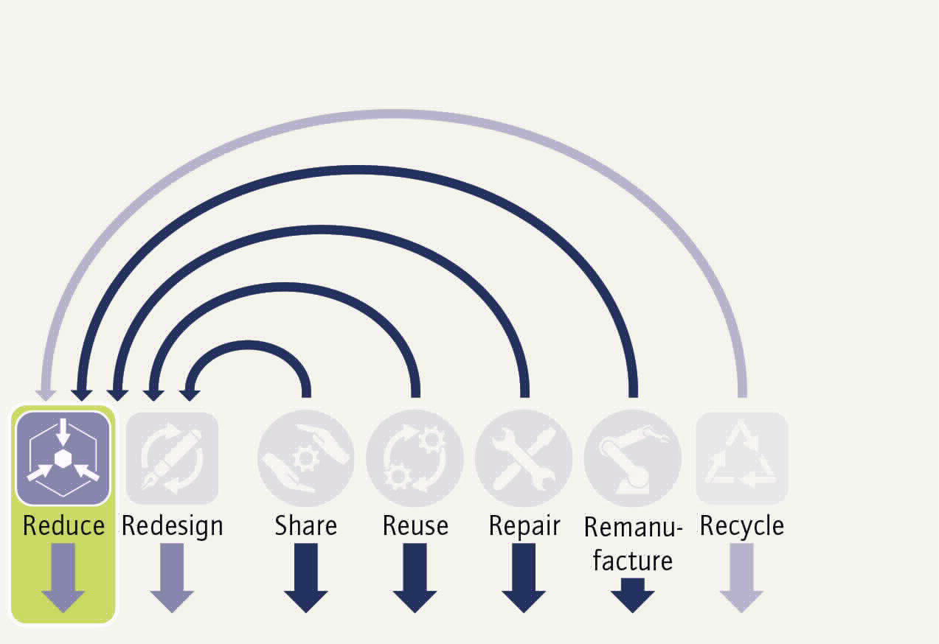
Refuse and reduction are essential levers.
Reduce is at the top of the waste hierarchy. Options to reduce material use are:
Waste prevention through an optimised manufacturing process with more efficient resource usage.
Waste prevention through design adjustments in the product design that ensure a more efficient use of resources and materials. However, this approach must be closely coordinated with the “Redesign” strategy to ensure joined up thinking when it comes to the quantity and quality of material for value retention by closed-loop management.
Consideration must also be given to the “Refuse” lever upstream of “Reduce”: its aim is to make a product redundant by abandoning its function or by offering the same function with a completely different product.
Sources: Kirchherr et al. (2017), adapted from Potting et al. (2017); Unruh/ Mast/ Irrek, Prosperkolleg, 2022.
EXAMPLES
Avoid unnecessary packaging, e.g. for fruit by “Natural Branding” with lasers, Apeel, a plant-based protective coating or Traceless, a naturally compostable biopolymer
Avoid water use through process innovation in textile dyeing, e.g. DyeCoo, which completely replaces water with CO₂ in a closed loop, SpinDye® waterless polyester dyeing
Notes:
The waste hierarchy is part of the European Union’s Waste Framework Directive. https://eur-lex.europa.eu/legal-content/EN/TXT/?uri=CELEX:32008L0098
It provides for five waste stages: a) avoidance, b) preparation for reuse, c) recycling, d) other recovery, e.g. energy recovery, e) disposal.
The circular strategy “Reduce” thus aims at the first stage and originally focuses on reducing waste. A comprehensive Circular Economy takes an even broader view, considering to be about reducing resource use.
Examples:
Natural branding is a laser process that “tattoos” fresh fruit and vegetables, but also baked goods, by removing pigments in the outer layer. This technique is used, e.g., to apply the organic label to avocados, melons and sweet potatoes. There are several suppliers, including Bluhm Systeme.
Apeel is an American company whose product innovation protects food without the use of plastic film. Apeel’s protective coating is made of vegetable fats and is designed to keep fruit and vegetables fresh for longer. This saves packaging materials and helps to avoid food waste.
Traceless is a circular bioeconomy start-up from Hamburg which produces a plastic-free biopolymer based on agro-industrial waste that is compostable in a natural environment. The Traceless material thus belongs to a new generation of advanced natural materials that are more than conventional bioplastics. Bioplastics are mostly “only” of bio-based origin and can only be composted, if at all, under industrial conditions with suitable temperature, pressure and long cycles.
DyeCoo is a company from the Netherlands which has developed an innovative process for dyeing textiles. The process does not require the use of water or chemicals and no waste water is produced. For the dyeing process, recovered carbon dioxide is heated and used under elevated pressure for the dyeing process. In addition, the carbon dioxide is kept in a closed circuit and 95% of it can be reused in the dyeing process.
The Swedish company SpinDye completely eliminates the use of water in its dyeing process for recycled polyester materials by incorporating colour during production of the polyester fibres. The colour pigment is thus integrated into the material right from the outset without using water.

Slide 14
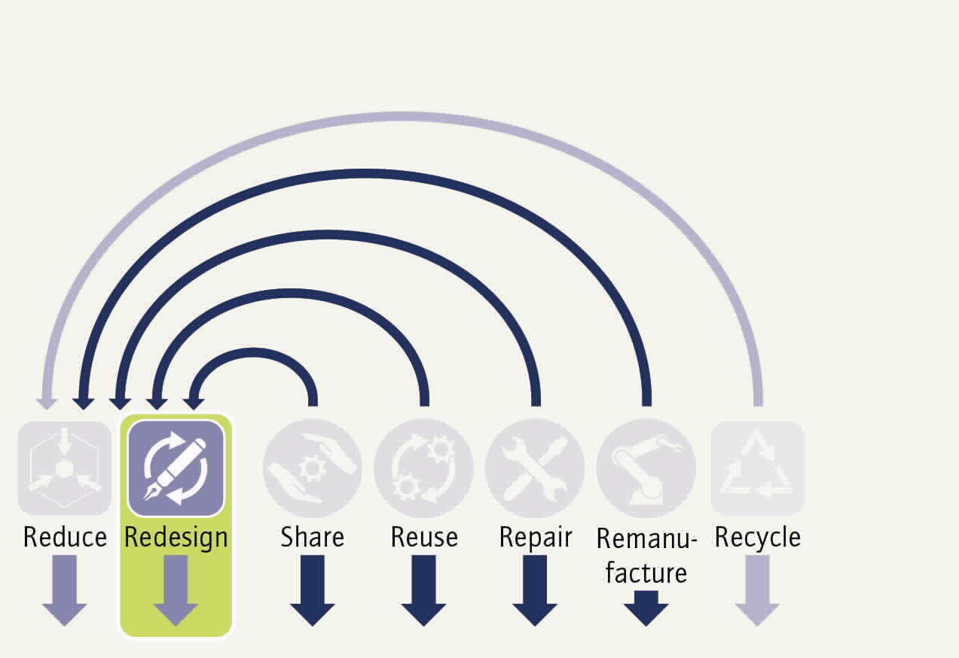
Design for circularity is the enabler of a Circular Economy.
Design practices must be adapted if it is to enable Circular Economy strategies.
Design-for-circularity-strategies aim at enhancing product durability and recyclability:
Design for Reliability and Durability
Design for Ease of Maintenance and Repair
Design for Upgradability and Adaptability
Design for Standardisation
Design for Dis- and Reassembly
Design for Refurbishment/Remanufacturing
Safe by Design (i.e. avoiding toxic or harmful substances)
Design for Recycling
EXAMPLES
Replaceable modules in technical devices, e.g. Fairphone and Shiftphone with easily replaceable displays, batteries or cameras.
Design of recyclable packaging, e.g. Ecover Plantastic bottles, Frosch (Werner & Mertz) stand-up pouches made of fully recyclable material and removable band.
Notes:
The “redesign” strategy is the basis for many other circular strategies. Design is an important step because it determines how sustainable a product can ultimately become before it is produced, used and disposed of.
Product durability can be supported by the use of strong, high-quality materials and solid construction.
Product repairability can be supported by a simple and modular design.
Product upgradeability determines whether digital components can be easily updated or replaced.
The standardisation of certain components can help to avoid the repeated development of new product variants (e.g. chargers)
Design for Dis- and Reassembly specifies how easily and quickly products can be disassembled and reassembled.
Purposeful optimisation of product design for refurbishing and remanufacturing processes ensures that appliances can be easily disassembled into their components and that these can once again be effectively refurbished and remanufactured.
The avoidance of toxic or hazardous substances in materials and products is an important prerequisite for closed-loop management and ensures that there is no accumulation of these substances in the life cycles.
Recycling is the last step in a product’s life cycle; the quality of the recycled products depends largely on the purity of the materials in the input stream and decreases with increasing complexity of materials streams.
Examples:
Fairphone, manufactured by a Dutch company, is - unlike many common mobile phones - modularly designed and easy to disassemble. Spare parts can be ordered from the manufacturer and installed relatively easily by users with the help of comprehensive repair instructions.
The German brand Frosch from Werner & Merz has developed a monomaterial stand-up pouch made of recycled material, which has also been optimised for complete recyclability. This meets the Gold criteria in the material recycling category of the Cradle to Cradle certification.
Ecover is a Belgian group of companies that develops ecological detergents and cleaning products. Its Professional range of packaging bottles are now made entirely from Plantastic polyethylene (PE), a plastic made from sugar cane residues that is 100% renewable, reusable and recyclable. These Plantastic bottles also meet the Gold criteria in the material recovery category of the Cradle to Cradle certification.

Slide 15
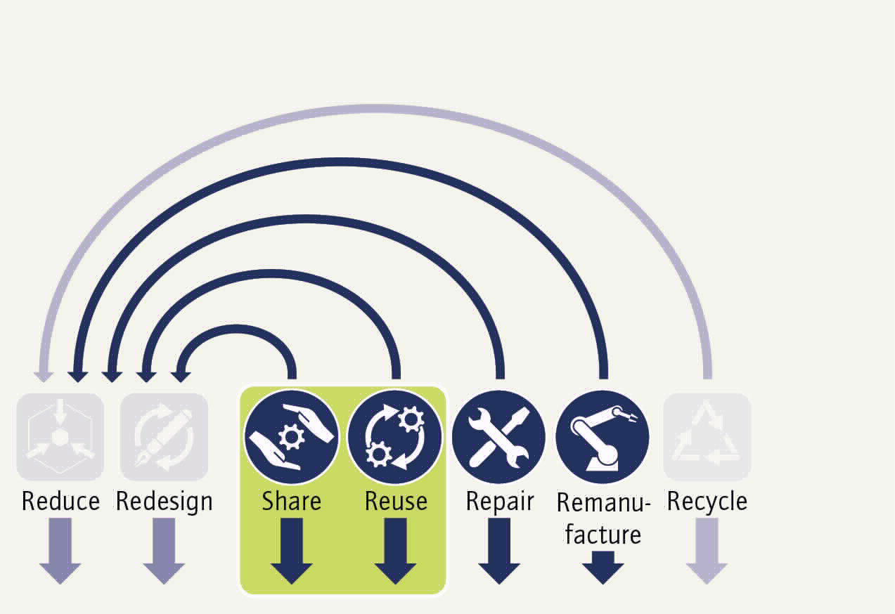
Use products as long and intensively as possible.
In order to reduce demand for new products and to conserve resources, more intensive and longer use of products must be enabled.
This can be implemented through new business models and more conscious consumption with a focus on the following strategies:
Share
Continued use and reuse
To increase acceptance of these new business models and make them a success, knowledge about the basic principles of the Circular Economy must become widely embedded in society. Providing appropriate information will allow consumers to adapt their usage behaviour.
EXAMPLES
Rental model for machinery, e.g. Rubble Master Rentals rents out mobile recycling machines and later offers them as used products
Multi-trip systems for food and drink, e.g. Recup’s deposit-based system and Vytal’s deposit-free system
Used goods platforms, e.g. ebay classified advertisements for consumer-to-consumer sales
Notes:
The Share and Reuse strategies ensure that products that are already manufactured and in circulation remain in use as long as possible and are used as intensively as possible. To intensify the use of products, the Share strategy aims to encourage sharing of a machine or product instead of each person buying their own. Such sharing and leasing models also incentivise product reuse; accordingly, the respective business models often address both share and reuse strategies together.
Share: In sharing, products are used more intensively (less downtime) and a smaller total number of products is needed on the market. In principle, this enables the procurement of higher-quality products, as the investment pays off more quickly.
Reuse: Here, a product that has reached the end of its initial use is reused for the same purpose for which it was originally intended.
Examples:
The Austrian company Rubble Master Rentals is a leading manufacturer of mobile recycling machines (e.g. crushers, sorters) for construction waste. In addition to the sale of new products, the company offers a rental division that gives customers access to a product pool (i.e. a business model with rental machines). Rental includes training and wear and tear, but not operating costs (e.g. fuel, machine operator) or transport. Some of the machines from the rental pool are later sold as used products at lower prices so that customers with smaller budgets can also be served; this demonstrates the interconnectedness of the rental and used machine business.
The German start-up Recup offers a deposit-based multi-trip system for take-away drinks. When you buy a coffee, you get a RECUP instead of a disposable cup for a deposit of 1€. After use, customers can return the cups to one of over 4000 partner shops across Germany and also get their deposit back. Coffee suppliers also purchase the cups from RECUP for 1€ per unit, so there are no costs for them as the deposit is passed on to the customers.
The German start-up Vytal operates a digital and deposit-free reusable platform that works according to the library principle: each container for food or drinks is labelled with an individual QR code and name. Restaurateurs lend it to their customers by scanning it with the Vytal Partner App, the price per use being less than that for their disposable packaging. For consumers, borrowing via the Vytal app is free of charge if returned within 14 days.
The Norwegian company Adevinta provides ebay classified advertisements, a second-hand goods platform through which consumers can offer other consumers used products for sale, specifying a price as well as other characteristics of the item. The buyer contacts the seller and together they complete the transaction outside the eBay platform.

Slide 16
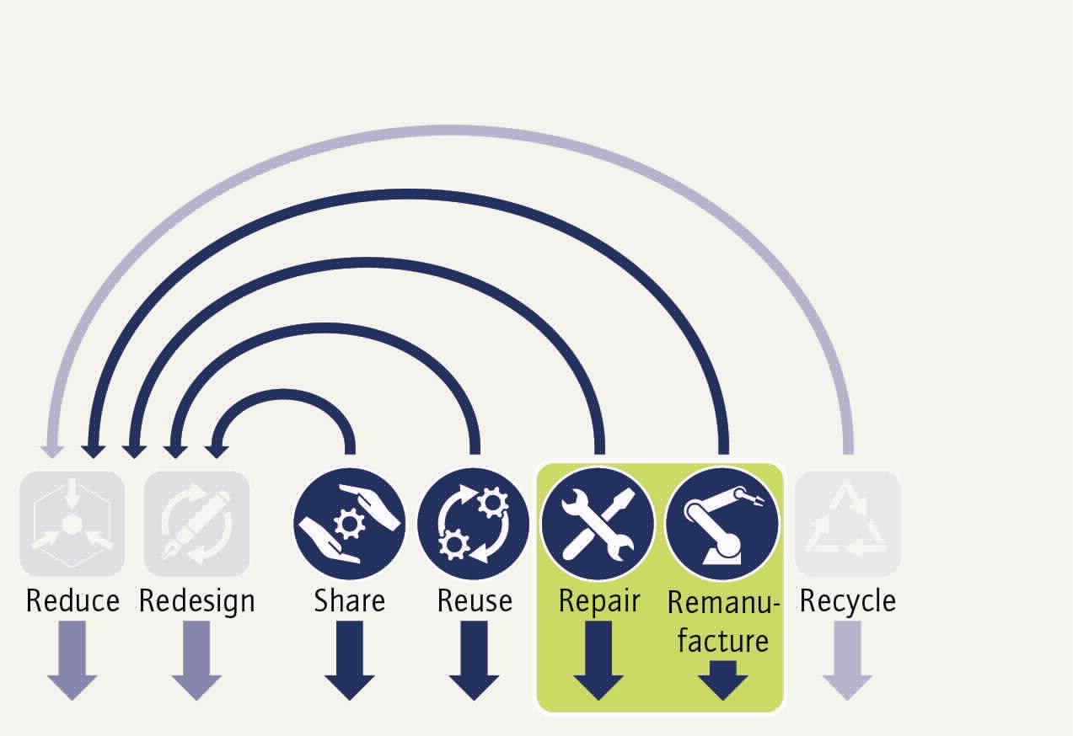
Extending the life cycle of products and components.
Extending the usability and functionality of products can reduce the need to buy or switch to new products.
Accordingly, business models focus on concrete measures to extend the life cycle of a product or its components:
Maintenance, upgrade, repair
Remanufacture
Maintenance, upgrade and repair services aim to ensure that a product (again) delivers, or possibly even improves on, its required performance. Remanufacture restores previously used or non-functional products or components to an “as new” or “better than new” state.
EXAMPLES
Repair services for products, e.g. Miele’s repair and maintenance contracts for white goods, Bosch’s “BlueMovement”, Deuter’s “Lifetime Repair Service” for outdoor equipment
Maintenance, repair and remanufacture of components, e.g. SKF’s “Rotation for Life” for roller bearings, TRUMPF used machinery, Liebherr Reman
Notes:
The maintenance, repair, upgrade and remanufacturing strategies aim to extend the life cycle of products and components through targeted measures.
The circular strategies of maintenance and upgrade are mentioned here because they often precede repair.
Maintenance: Combination of all technical and managerial measures designed to maintain or restore an item to a condition in which it can perform as required.
Repair: The process of returning a defective product to a condition in which it can fulfil its intended use.
Upgrade: Process to improve the functionality, performance, capacity or aesthetics of a product.
Remanufacture: Industrial process in which a previously used or non-functional product or component is restored to an “as new” or “better than new” condition.
Examples:
Miele is a German manufacturer of white goods and other household electronics. With its reputation for high-quality consumer goods and a strong service culture, the company has maintained premium prices in the market. Miele products are manufactured in both Europe and China and have a significantly longer service life than competitor products. With local trade and service partners in major cities, Miele remains close to its customers. Comprehensive customer support at local sales outlets is an important differentiator. Repair and maintenance contracts can be arranged locally and are supported by a central online service. Individual components of products can usually be replaced if they break or wear out, and minor software upgrades can be carried out.
BlueMovement powered by Bosch offers a subscription model for white goods to end customers in the Netherlands and Germany, with a choice between refurbished and new equipment. The full-service approach includes delivery, installation and repair services and can be booked with different durations.
German outdoor equipment manufacturer Deuter offers a lifetime repair service. Within a two-year warranty period, Deuter will remedy free of charge, either by repairing or replacing the product, any defects that are due to material or manufacturing faults. Once the warranty period has elapsed, the company repairs the products to restore their functionality for a small cost contribution from the customer.
SKF, based in Sweden, is the world’s largest manufacturer of rolling bearings. Rolling bearings are critical components in many types of machinery and equipment. SKF has recently introduced a “rotation for life” business model that focuses on total cost of ownership, with payments based on rolling bearing performance metrics. The rolling bearings are digitally monitored, removed if there is a risk of failure, replaced and remanufactured.

Slide 17
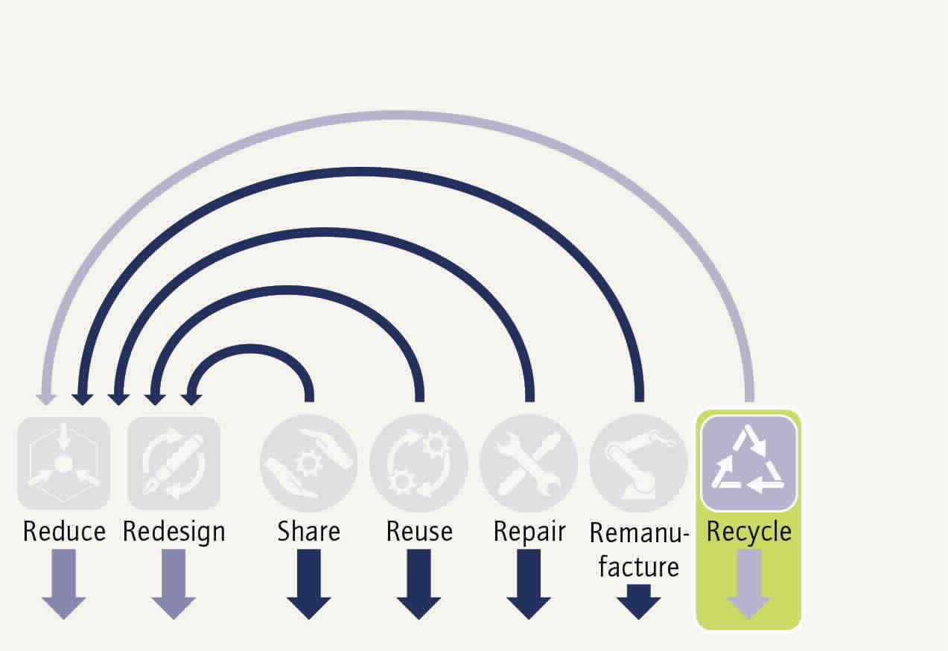
Only high-quality recycling can replace primary raw materials.
Recycling is about reusing materials for the same or a new purpose so that primary raw materials requirements can be reduced.
However, today’s recycling processes are often still accompanied by a reduction in material quality. This means that recycled materials cannot be used in similarly high-quality applications and are associated with a loss in value.
To improve the quality of recycled material, recycling needs to focus not only on improving the input stream of materials but also on output quality.
Since the value retained in products and components is lost during recycling, this measure should always be considered the last resort.
EXAMPLES
Molecular and material recycling, e.g. Borealis AG as a supplier of virgin as well as recycled polyolefins
Market place for recycled materials and plastics waste, e.g. cirplus for the plastics and recycling industry.
Recycling strategy in retailing, e.g. the Schwarz Group which coordinates material streams by vertical integration into recovery management and recycling.
Notes:
When a product and its components have reached the end of their life cycle and can no longer be used, the materials should be recycled. It is important to understand that recycling is less beneficial than repair, reuse or remanufacture, as much of the energy and labour used to make the product is lost in this step.
New business models and associated product design changes aim to maintain material quality over multiple cycles and long periods of time so that primary materials can be substituted. Achieving high-quality recycling requires cooperation along the value chain - from product design (design for recycling) to the recycling infrastructure.
Examples:
Austria’s Borealis AG, the eighth largest chemical manufacturer of polyolefins (e.g. polyethylene (PE) and polypropylene (PP)), is a good example of a company that recycles molecules and materials. In 2016, Borealis started to invest in several recycling plants in Europe and has moved from supplying virgin polyolefins to supplying both virgin and recycled polyolefins. Since then, the company has used learning processes from its recycling operation, especially in relation to barriers to recycling. For example, yellow plastic waste contaminated with cadmium (e.g. as dye or ink) hinders most recycled material applications. This has led to major Circular Economy initiatives such as EverMinds, where Borealis has worked with stakeholders across the entire value chain to propose, for example, new circular design guidelines for plastic packaging to maximise the recovery of high-value materials and to enable higher performance use scenarios for recycled resources.
The German start-up cirplus is a global marketplace for recycled materials and plastics waste that has set itself the task of making the buying and selling of recycled plastics easier and more efficient than before. This B2B marketplace connects the plastics and recycling industries. cirplus focuses on improving the quality and quantities of recycled plastics. In addition, advisory services are offered to support companies along the value chain, e.g. in improving input materials, recycling-friendly product design or material flows.
Germany’s Schwarz Group owns Lidl and Kaufland and is considered Europe’s largest retail chain. In 2018, it launched the “REset Plastic” strategy. This ambitious, value chain-spanning strategy is based on vertical integration in waste and materials management, with the aim of introducing 100% recyclable packaging and reducing plastics waste. As a first building block, the Schwarz Group founded the waste management companies GreenCycle (for the management of intra-group waste) in 2009 and the digital waste management platform PreZero (for external partners in the market) in 2018. In addition, the Schwarz Group has acquired two recycling companies since 2018: Tönsmeier in Germany and Sky Plastic Group AG in Austria. The Schwarz Group is the first retailer to be capable of coordinating materials streams across the entire value chain through vertical integration into recovery management and recycling.

Slide 18
Discussion
What applications or practical examples of circular strategies can you think of?
Notes:
Let’s now review the circular strategies. Where have you yourself used products and services in everyday life that fit into the strategies? What interesting business models come to mind? Which goals are these directed towards? Do the solutions really correspond to a comprehensive definition of a Circular Economy?

Slide 19
03
What will it take to implement a sustainable Circular Economy?

Slide 20
A Circular Economy requires collaboration in circular ecosystems.
Circular business models...
...create entrepreneurial added value.
...assist the systemic shift to a Circular Economy.
...must be coordinated with one another.
A business model ecosystem makes this possible.
Actor
Actor
Product Service
Business model
Ecosystem
​Decision makers at the meso and macro levels can add value to the business model ecosystem and support the systemic shift to a Circular Economy.
Actor
Actor
Source: Circular Economy Initiative Deutschland (2021): “Circular Business Models: Overcoming Barriers, Unleashing Potentials” Fig. 4: Ecosystem perspective on circular business model, source: Konietzko et al. (2020)
Notes:
Business models are a central starting point enabling companies to adopt the Circular Economy in an entrepreneurial way. Ideally, a business model aligns circular value creation activities with entrepreneurial opportunities to create economic value.
However, the isolated optimisation and profit maximisation of the business models of individual stakeholders no longer meets the requirements of a Circular Economy. In order to effectively transform existing value chains into value cycles, circular ecosystems of mutually complementary value-adding stakeholders need to be holistically considered and designed.
The circular business models of the stakeholders within the value cycle must be coordinated with one another, with one stakeholder actor taking on the role of a central orchestrator, so that the joint value creation activities achieve true circularity at the system level.
In addition to the more micro-level business model ecosystem, which focuses on core partnerships for the provision of circular solutions, the broader meso- and macro-level ecosystem encompasses other relevant stakeholder groups at the levels of communities, municipalities and states, as well as the respective cultures, and is therefore linked to diverse institutional structures.

Slide 21
Digital technologies are key to implement circular strategies.
Digital technologies act as a link between the circular business models of partners in the value chain and the associated stakeholders by enabling data exchange
and increased transparency.
Digitalisation thus helps to
extend product service life and value retention
close resource loops
overcome barriers to implementing circular business models
EXAMPLES
Unique identifiers or tracking codes (barcode or radio-frequency ID tag) for marking products, components and materials
Digital product or material passports providing information about origin, composition, repair and disassembly instructions & end-of-life handling guidelines
Databases providing life cycle information for specific products
Source: Circular Economy Initiative Deutschland (2021): “Circular Business Models: Overcoming Barriers, Unleashing Potentials; Fig.: photo by NASA on Unsplash.
Notes:
Digital technologies are key element to the development of the Circular Economy. They can help overcome barriers to the implementation of circular strategies, product-service systems and circular business models.
The availability of information and the transparency generated by product life cycle data open up far-reaching opportunities to extend product service life, to maintain the value of products over their service life and to close resource loops.
The application of digital technologies - such as the Internet of Things (IoT), digital twins, digital product passports, online platforms, blockchain technology, Big Data, analytics and artificial intelligence - can play an important role in implementing the Circular Economy.
Digital technologies can help to close the information gap that currently prevents circular strategies from being effective or even adopted in the first place. For example, a unique identifier or tracking code (e.g., barcode, radio frequency identification tag or molecular marker) could be used to mark products, components and materials. The product passport (or in a narrower sense the material passport) provides stakeholders in the value chain with information about the origin, composition (including substances of concern), repair and disassembly instructions as well as guidelines for end-of-life handling.
In addition, life cycle information could be collected for specific products and stored in corresponding databases. For example, the condition of products and components could be recorded with sensors to determine how long they can continue to be used. In addition, utilisation and performance data could be used to identify opportunities to repurpose plant and machinery or match supply and demand in secondary markets. Ultimately, digital technologies could enable companies to route products through the value cycle, unlock new circular value propositions and deliver new circular offerings.

Slide 22
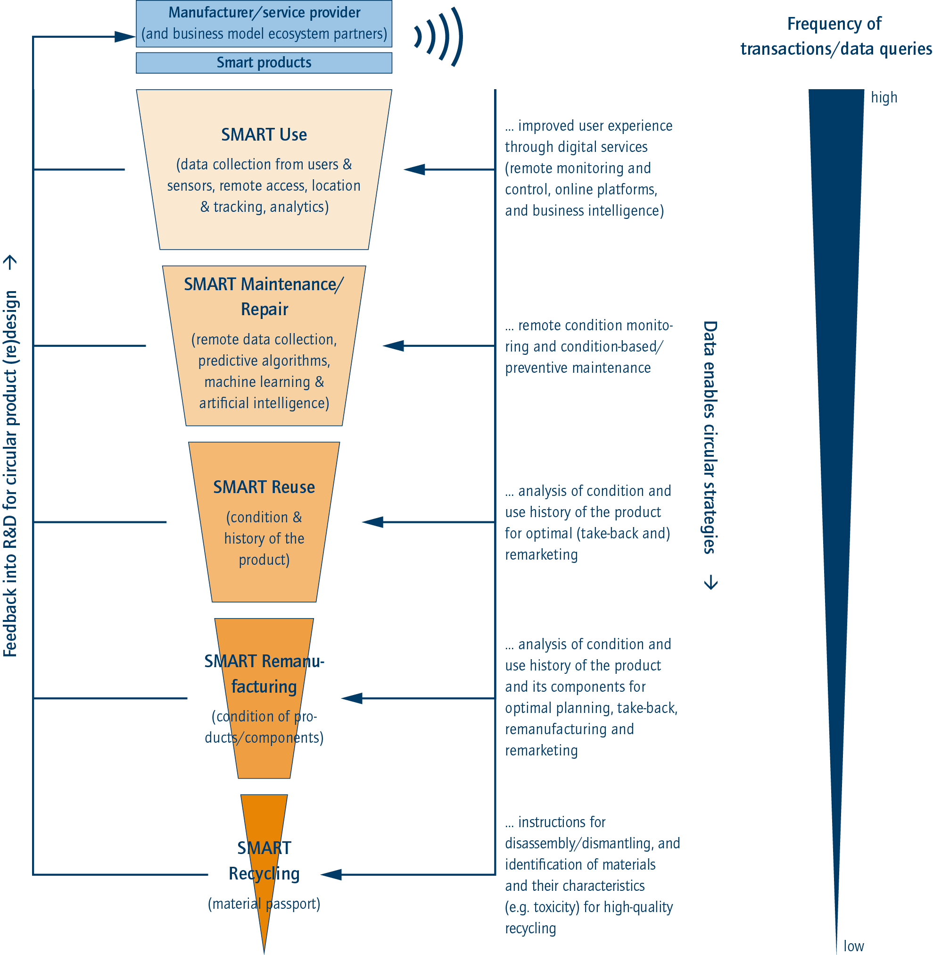
Added value through targeted use of data
Smart products provide important information which can be used for decision-making processes.
Various services in different phases of the life cycle can be implemented on this basis.
The frequency of transactions and associated data queries decreases over the course of the life cycle.
Using product life cycle data enables improvements to the circular design of future generations of products.
Source: Circular Economy Initiative Deutschland (2021): “Circular Business Models: Overcoming Barriers, Unleashing Potentials”
Notes:
The figure illustrates howdigital service elements can become the basis for smart strategies in maintenance/repair, reuse, remanufacturing and recycling.
Smart recycling: At material level, information about dismantling and material properties can be made available in a material passport, on the basis of which decisions can be made about the appropriate recycling processes.
Smart remanufacturing and reuse: Digital technologies can provide information about the condition and usage history of the product and its components, on the basis of which decisions can be made on the remaining value and appropriate take-back, as well as possible remarketing or remanufacturing.
Smart maintenance and repair: Component monitoring enables manufacturers to constantly record the functionality of the product and thus carry out preventive repair work in good time.
Smart use: Data collection on user behaviour allows conclusions to be drawn about possible product improvements; these can be incorporated into product design with the aim of improving the user experience.

Slide 23
04
What do circular business models involve?

Slide 24
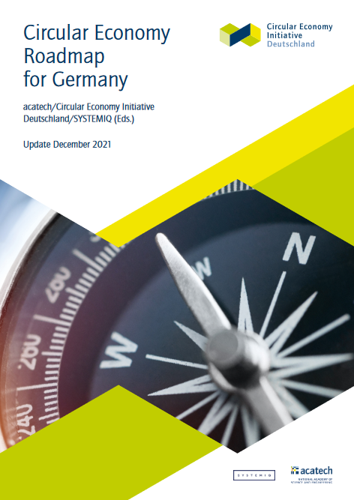
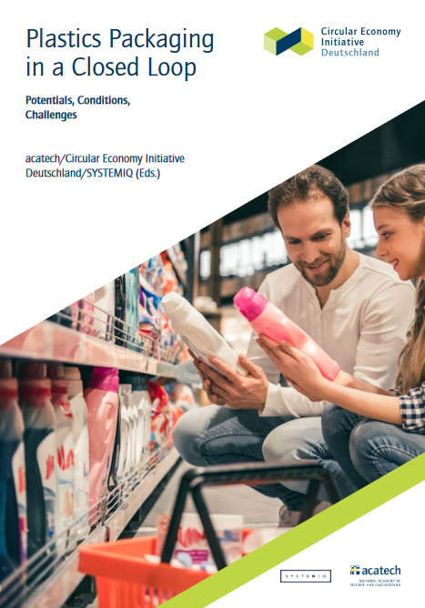
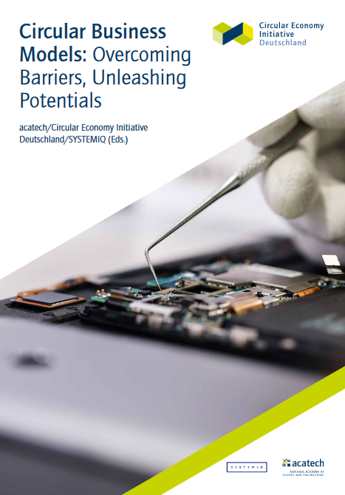
The strategy game builds on scientific evidence about circular business models.
The Circular Economy Initiative Deutschland (CEID) gave rise to the “Circular Economy Roadmap for Germany” which provides policy recommendations for Germany’s transition to a Circular Economy.
The strategy game and workshop materials are based on the interdisciplinary and cross-sector working group’s work on circular business models.
Notes:
The content of the strategy game and the workshop materials build on scientific insights into circular business models.
Within the framework of the Circular Economy Initiative Deutschland (CEID) , around 130 participants from business, science and civil society formulated policy recommendations in the “Circular Economy Roadmap for Germany”, which are intended to guide decision-makers from politics, business and science in Germany’s transition to a Circular Economy.
In interdisciplinary and cross-sectoral working groups (WGs), the experts discussed how circular economic systems can be enabled and implemented. The WG’s work on circular business models forms the basis for the strategy game.

Slide 25
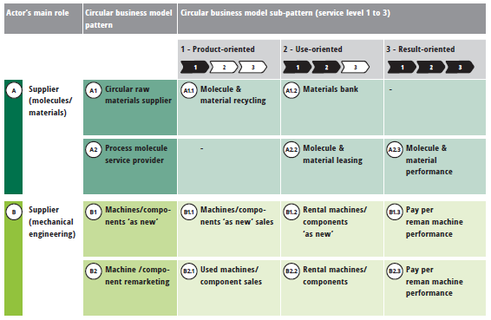
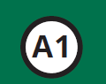
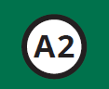
Three easy steps to a circular business model...
This process gives rise to a typology with 22 business model patterns and 43 business model variants
The primary (current) role of the stakeholder in value creation process
The resulting possible circular
business model patterns
Pattern
Pattern
Variants of the business model
patterns with different service levels
Source: Circular Economy Initiative Deutschland (2021): “Circular Business Models: Overcoming Barriers, Unleashing Potentials”; table: Overview of circular business model patterns and sub-patterns, source: own presentation based on Hansen et al. (2020a, p. 13)
Notes:
Building on the content of the Circular Economy Initiative, circular business models can be developed in three steps:
- determining the stakeholder’s primary (current) role in value creation
- deriving the resultant, possible circular business model patterns
- developing business model variants from service level 1-3
These steps are explained in more detail on the next slides.
This results in a typology with a total of 22 different business model patterns or 43 business model variants, some of which can be seen here in the table.

Slide 26
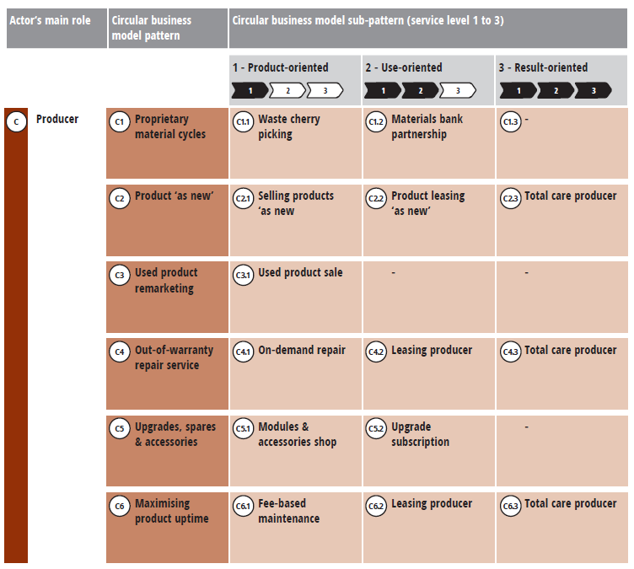
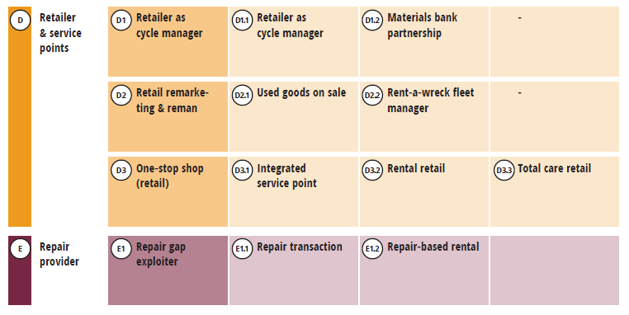
Circular business models can be developed from different stakeholder perspectives.
Primary role in value creation
There are numerous possibilities for the primary (current) role in value creation:
supplier, manufacturer, retailer, repair service provider, prosumer, logistics service provider, recovery manager, intermediary, or new stakeholder.
The positions of stakeholders in the value chain can change in a Circular Economy.
Stakeholders may have to act outside their traditional roles and take on additional roles.
Source: Circular Economy Initiative Deutschland (2021): “Circular Business Models: Overcoming Barriers, Unleashing Potentials”; table: Overview of circular business model patterns and sub-patterns, source: own presentation based on Hansen et al. (2020a, p. 13)
Notes:
There are a variety of options when determining the primary role in value creation. For example, new business models can be developed from the role or perspective of suppliers, manufacturers, repair service providers or logistics service providers. However, in a Circular Economy, the respective positions of the stakeholders in the value chain may change. Stakeholders may have to act outside their traditional roles and take on additional roles.

Slide 27
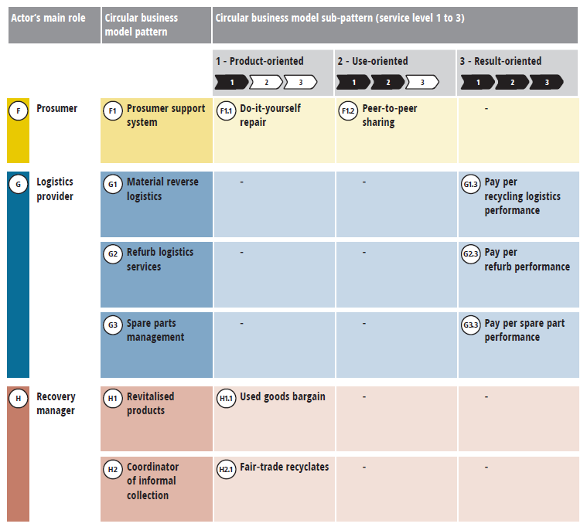
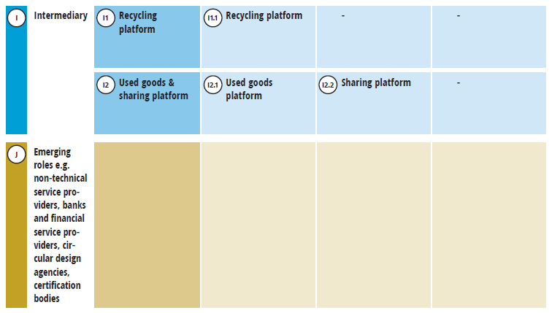
Various circular business model patterns emerge from the stakeholder’s role.
Pattern
Pattern
Circular business model patterns
Various circular business model patterns can be derived from the stakeholder’s primary role.
These are for example circular raw material supply, remarketing of machines and components, or commercial repair services.
Overall, this results in a typology of 22 circular business model patterns.
Source: Circular Economy Initiative Deutschland (2021): “Circular Business Models: Overcoming Barriers, Unleashing Potentials”; table: Overview of circular business model patterns and sub-patterns, source: own presentation based on Hansen et al. (2020a, p. 13)

Slide 28
The service level determines the nature of implementation.
The service level varies between a product-, use- and results-oriented approach
Product-service system
Product creates value
Service component (intangible)
Service creates value
Product component (tangible)
Product only
Product-oriented
Product-related
Consultancy and support
Use-oriented
Product leasing
Rental/sharing
Product pooling
Results-oriented
Outsourcing
Pay-per-service unit
Functional result
Service only
Product-oriented business models:
The aim is to maximise the number of products sold, thus increasing turnover and market share and generating profits.
Service-oriented business models:
Payment for offered service + products and consumables that play a part in providing the service become cost factors.
Companies have an incentive to…
…extend product service life,
…use products as intensively as possible,
…manufacture products of the highest possible quality and in a recyclable form,
…reuse parts as much as possible following the end of the product’s life.
Source: Circular Economy Initiative Deutschland (2021): “Circular Business Models: Overcoming Barriers, Unleashing Potentials”; based on Tukker (2004, p. 248)
Notes:
The service level now decides on the implementation of the business model pattern. The service level of circular business models can be represented as a continuum of product-, use- and results-oriented services: a product-service system with a high product component or a high service component.
In product-oriented business models, companies have the incentive to maximise the number of products sold so as to increase turnover, increase market share and generate profits. These are products and services with a strong product focus, e.g. advice and support.
In service-based business models, the incentive is different. Companies make money by being paid for the service they provide, and the products and consumables that play a role in providing the service become cost factors. Companies thus have an incentive to extend product service life, to make use of products as intensively as possible, to manufacture them as cost- and material-efficiently as possible and to reuse parts at the end of the product’s life.
Use-oriented services can be, e.g., product leasing, rental or sharing offers or product pooling.
Results-oriented services are, e.g., outsourcing, pay-per-service unit or a functional result.
Results-oriented product-service systems are seen as those with the greatest potential for the Circular Economy, but they also require the most radical changes to the business model and have therefore not yet gained widespread acceptance.

Slide 29
Example: “Television” use case
Service level
Product-oriented
Use-oriented
Results-oriented
incl.
Scenario 1: Sale + repair
Sale of circular televisions plus repair offerings
Scenario 2: Leasing or rental + service
Sale of (temporary) use of televisions with the assistance of leasing models
Scenario 3: Pay-per-view + all-round service
Sale of entertainment-services (based on televisions or alternative terminals)
Primary role Manufacturer
Primary role
Retailer
Primary role Content provider
Source: Circular Economy Initiative Deutschland (2021): “Circular Business Models: Overcoming Barriers, Unleashing Potentials”
Notes:
The use case “television” serves to illustrate the continuum of a product-service system.
Scenario 1 represents a product-oriented business model for televisions. This level of service focuses on the sale of the television
as a product with additional services, e.g. repair offers. In this case, the primary stakeholder role is that of a manufacturer; another relevant role could be that of the repair service provider.
Scenario 2 represents a business model based on selling the (temporary) use of the television. This can take the form, e.g., of television rental or leasing (+ possible further services). Here, the primary role of the stakeholder is that of the retailer. But other roles such as repair/maintenance service provider, recovery manager or intermediary may now also be relevant.
Scenario 3 shows a results-oriented business model and is based on the sale of the service provided by the television. This can take the form of a pay-per-view model or an all-round service offer (incl. software updates), e.g.. Here the user no longer pays for the product, but for the result provided. The primary stakeholder role is that of the content provider. As in scenario 2, however, other relevant roles now come into consideration.

Slide 30
05
Presentation of the strategy game

Slide 31
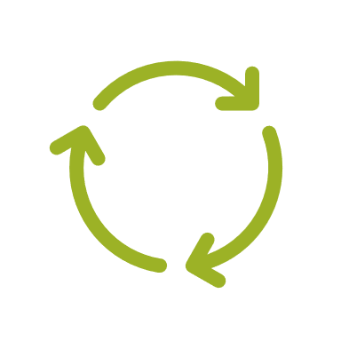
Development of the strategy game
Content: CEID working group’s typology of circular business models
Goal: As many German companies as possible understand Circular Economy approaches and develop circular business models.
With the help of this strategy game, companies should:
can learn about circular business models,
put their existing business model to the test in light of new know-how and
identify possible circular solutions for their business.
Notes:
The strategy game builds on the CEID Circular Business Models WG’s business model typology.
The strategy game was developed with the aim of enabling as many companies as possible to engage with the Circular Economy and ultimately develop circular business models themselves.
It is intended to enable companies to inform themselves independently about possible circular business model approaches and to put their previous business model to the test in the light of new know-how. In addition, companies should find possible circular solutions for their business through the strategy game.

Slide 32
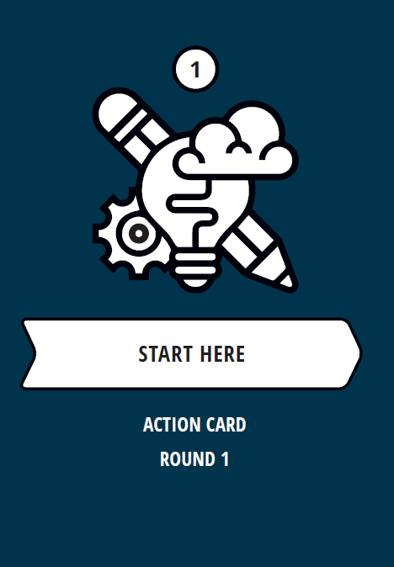
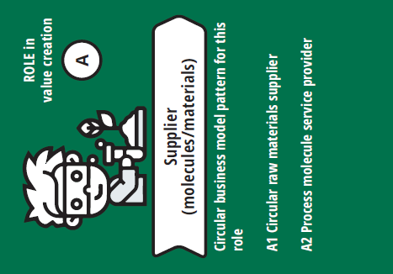
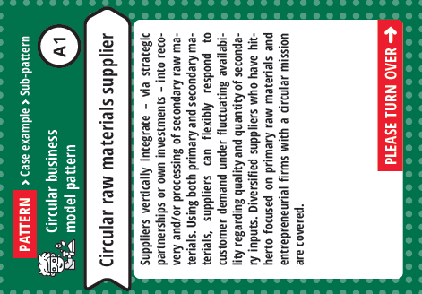
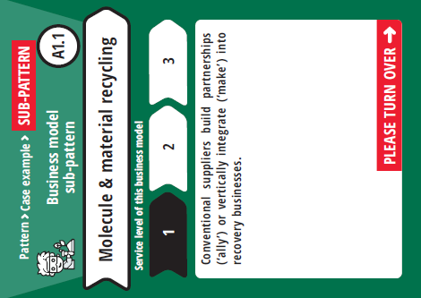
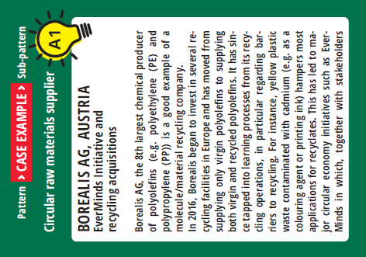
The playing cards will introduce you to circular business models.
There are five categories of playing cards:
1
2
3
4
5
Action cards lead you through the game.
Use role cards to identify your own role in the value chain.
Pattern cards describe the underlying circular business model pattern on the basis of your role.
Variant cards show you the various service levels of the product-service system of the business model patterns.
Practical examples present case studies to illustrate the business model pattern.
Notes:
The strategy game includes five categories of playing cards that introduce you to circular business model solutions.
1. Nine action cards guide you through the game with appropriate instructions.
2. Ten role cards teach you about different roles in the value cycle and help you identify your own role.
3. A total of 22 “pattern” cards illustrate various basic circular business model patterns for you.
4. “Practical example” cards describe an illustrative example of each business model pattern.
5. “Variant” cards teach you about different variants of the business model patterns. These are based on the respective service level of the business model pattern.

Slide 33
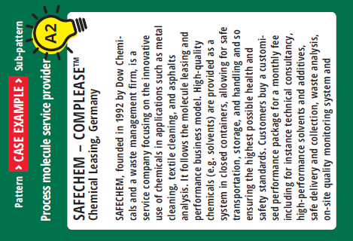
Discussion with use cases
Read the use case and answer the following questions:
Is there anything you don’t understand?
Can you summarise the business model in one sentence?
What is innovative about this business model?
Notes:
To provide a more detailed picture of the topic of circular business models, let’s take a look at a few examples. Three of the use case cards are now distributed among the participants.
Please read the use case aloud one after the other. For each of the three practical examples, we answer the following questions: 1. Is there anything you don’t understand?
2. Can you summarise the business model again in a single sentence?
3. What is innovative about this business model?

Slide 34
Discussion: circular business models
What surprised you?
Have you learned anything new about circular business models?
What are your take-aways?
Notes:
Let’s zoom out now:
Have you learned anything new about circular business models?
What surprised you?
What will you take away?

Slide 35
Imprint
acatech – National Academy of Science and Engineering
Karolinenplatz 4
80333 Munich, Germany
assistenz-cei@acatech.de
WWF Deutschland
Reinhardstraße 18
10117 Berlin, Germany
unternehmen@wwf.de
assistenz-casei@acatech.de

